Slide 1
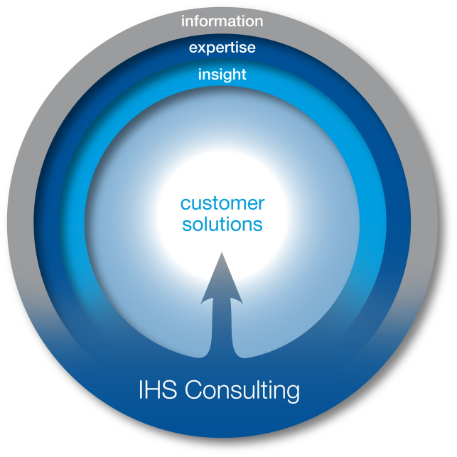
Rhode Island Tourism 2012
IHS Consulting

Slide 2


Advancing Decisions that Advance the World
  We are more than 5,500 people, in 30 countries, speaking 50 languages – all working each day to:
    Serve businesses and all levels of government worldwide
      Ranging from 80% of Global Fortune 500 to small businesses
      Customers in 167 countries
    Provide comprehensive content, software and expert analysis and forecasts
  Helping our customers drive critical processes and make high-impact decisions with speed and confidence
Energy &
Power
Design &
Supply Chain
Defense, Risk &
Security
EHS &
Sustainability
Country & Industry
Forecasts
Commodities,
Pricing & Cost

Slide 3

IHS Consulting & Advisory Services
IHS Consulting & Advisory Services
We help you make the leap from data to results.
Expertise
At IHS Consulting, we leverage our unmatched combination of information, insight and expertise to effect the powerful transformation of data into knowledge and value to our customers, helping them solve their greatest strategic and operational challenges.
Forecasting
Modeling
Analysis
Insight
Value Creation Path
Relationships
Identification
Matching
Capture
Sourcing
Critical Information
Source Data

Slide 4
Core Capabilities for Government Consulting
Economic Impact Analysis
  Key themes: effects of public policy on the economy, jobs, incomes, tax revenues
Economic Development Strategy
  Key themes: national investment, industrial development, cluster analysis, tourism analysis
Market Sizing & Forecasting
  Key themes: Product line forecasting, market size, market segmentation
Fraud, Waste & Abuse Analytics
  Key themes: predictive modeling, data mining, fraud detection

Slide 5
Travel and Tourism Expertise
Visitation & Spending Forecasts –by category and by country, region, state, or U.S. city. Market size, growth, and share.
Market Feasibility & Investment Facilitation market analysis & research, demand/supply review, policy evaluation, development cost analysis.
Destination Impact & Concession Support economic impact of the construction and operations of individual facilities –resort, convention center, entertainment venue, event…
Tourism Economic Impact & Tourism Satellite Accounting conforming to the UN/WTO standards. What does travel & tourism contribute in jobs, wages, spending, and taxes to a national or local economy?
Tourism Policy Analysis travel & tourism policy evaluation and rationalization.

Slide 6
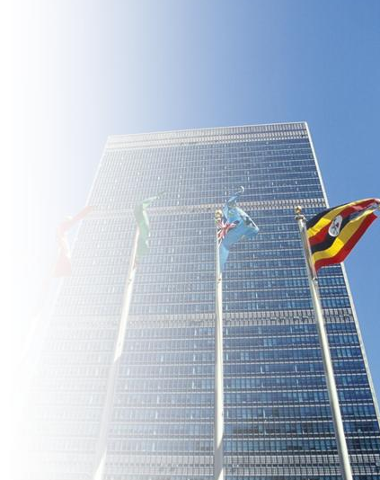
Tourism Satellite Accounting
The Tourism Satellite Account is the international (UN/WTO, OECD) standard for measuring the contribution of tourism to an economy
Measuring the industry “tourism” is difficult:
  Tourism industry is not measured in standard economic accounting systems.
  Most industries are accounted via the supply-side: firms are categorized into NAICS codes and asked about jobs, revenues, costs.
  But tourism is a demand-side activity:
  the focus is on what the traveler buys before and during a trip. As a result, tourism touches many industries
4Cs: Credibility, Comprehensiveness, Comparability, Consistency
6

Slide 7

Benefits of a TSA: Benchmarking & Analysis
Are we spending enough on tourism promotion and infrastructure? Compares government support of the tourism sector with government revenue generated by tourism.
Which are our best economic development targets and are candidate-requested concessions worth it? Allows policy-makers to compare the size & growth of tourism to other industrial sectors.
What is the ROI of public tourism investment? Enables analysts to assess long-term health of the tourism sector vis-a-vis capital investment and government support.
How can we benchmark ourselves against our destination competition? Provides an accepted international standard for benchmarking.
How can we communicate the full value of tourism to policy makers, businesses, and citizens? Quantifies how other industries benefit from tourism.
7

Slide 8
TSA and Tourism Economic Impact:
Client Examples
Tourism Satellite Account
  Rhode Island
  Kansas
  North Dakota
  New Jersey
  Bahamas
  Delaware
  Maryland
  Israel
  Dubai
  Abu Dhabi
  South Dakota
  Guam
  North Carolina
  Alaska
  South Carolina
  Virginia
  Utah
Economic Impact
  Idaho
  Pennsylvania
  Indiana
City Tourism Impact
  Washington, DC
  NYC
  Dallas
  Boston
  Arlington, TX
  Sacramento
  Baltimore
  Philadelphia
  Orlando
  Camden & SNJ
  Tulsa
  St. Louis
  Kansas City
  Battle Creek
  Durham, NC
  Savannah
  Pittsburgh
  Austin
  Indianapolis
  Omaha

Slide 9
Tourism Economic Impact: Definitions
Visitor: GT 50 miles, non-commuting; All overnight trips
Resident Tourism: Outbound purchases made in advance of a trip only. Resident usage of RI tourism assets are not included.
Tourism Expenditures: A TSA concept, includes all spending by all constituents on travel made in the state (RI), including tourism related investments
Visitor Spending: Spending in the jurisdiction by visitors (see above) (on accommodations, food & beverage, shopping, transportation, entertainment,…)
Economic Impact: “GDP” definition…spending less value of supply chain purchases made outside RI. The amount retained in the RI economy.
Import Leakages: The value of supply chain purchases made outside of RI.
Direct Spending/Jobs/Wages/Taxes: Industries that “touch” the visitor (e.g. hotels, restaurants, museums,…)
Indirect Spending/Jobs/Wages/Taxes: Industries that supply those that touch the visitor
Induced Spending/Jobs/Wages/Taxes: Workers of industries that touch or supply spend their wages locally
Core Impact: Impact results based purely off of visitor expenditures
Total Impact: Impact results Include investment, government support, and expenditures

Slide 10
Rhode Island Tourism Economic Impact - Definitions
TSA: Results (spending, economic impact, jobs,…) conform strictly to the TSA definition (e.g. 50mile+overnight visitor definition).
TSA + Under 50 Mile: TSA results, plus those coming from visitors traveling less than the 50 mile threshold. This classification is both historically consistent with previous studies and arguably more applicable to Rhode Island.
Approach
Total Impact: Total economic contribution of tourism to Rhode Island. Sum of core and non-core.
Core Impact: Economic contribution of from industries directly providing goods and services to the visitor.
Non-core Impact: Economic contribution from industries providing goods and services to core tourism providers. Also includes tourism investment.
Impact Sources

Slide 11
2012 Rhode Island Tourism Results

Slide 12
State Overview: 2012 Totals at a Glance
Tourism Concept | TSA + Under 50Mile Visitors | TSA | TSA ’11 – ’12 Growth
Visits | 18.45 M | 8.77 M | 4.4%
Expenditures | $5.75 B | $3.97 B | 3.7%
Total Economic Impact | $3.73 B | $2.64 B | 2.3%
Core Economic Impact (GSP) | $3.20 B | $2.25 B | 1.8%
Total Jobs | 64,607 | 43,014 | 2.2%
Wages | $2.21 B | $1.45 B | 2.3%
Taxes | $1,583 M | $1,059 M | 2.3%

Slide 13
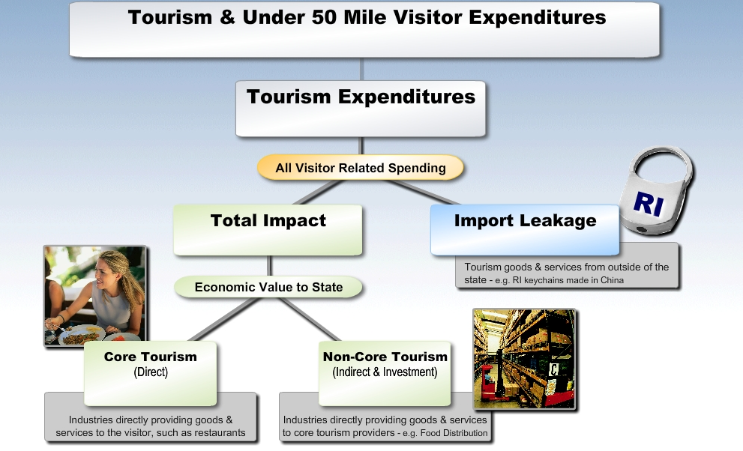
Industry Structure: Definitions
$5.75 billion
$3.97 billion
$2.64 billion
$1.33 billion
$2.25 billion
$468 million

Slide 14
State Overview:
Tourism and Under 50Mile Visitors – 2012 vs. 2011
Measurement | 2012 | 2011 | Definition
Tourism (TSA) + Under 50Mile Visitor Spending | $5.75B | $5.52B | Spending from all tourism factors
Tourism Expenditures (TSA) | $3.97B | $3.83B | TSA Definition of State Tourism
Under 50Mile Visitors | $1.78B | $1.69B | Spending by visitors from less than 50 miles that utilize RI tourism assets
Tourism + Under 50Mile Visitors Total Employment* | 64,607 | 62,636 | Employment required to support core RI tourism activity
Core Tourism (TSA) Employment* | 37,932 | 37,179 | TSA Definition of Tourism “Industry”

Slide 15

What Revisions Were Made to the 2010 Figures
Key Measurements | 2010 Original TSA | 2010 Recast TSA
RI Expenditures ($B) | $3.56B | $3.74B
Economic Value Core Tourism Total Impact | $1.64B $2.37B | $2.11B $2.50B
Wages & Salaries Core Tourism Total Impact | $872M $1,321M | $1,118M $1,374M
Employment (‘000) Core Tourism Total Impact | 32.99 41.93 | 35.47 40.73
Taxes –Total Impact | $930M | $984M
Each year revisions to most of the historical tourism metrics must be made in order to reflect:
New Baseline Data for IMPLAN interindustry model incorporating latest Census data
Revisions to the BLS and BEA inputs covering employment, Gross State Product, Sales Output, and Payroll for all industries at the jurisdiction county level.
Revision of investment data to include greater detail and new categories
Source: IHS Global Insight

Slide 16
Total Tourism (TSA) Expenditures
RI visitation increased by 4.4% in 2012
Spending per visit fell by 1.2% in 2012
Visitor spending grew 3.2% in 2012
Investment spending grew 18.9% in 2012
Tourism expenditures tallied $3.97 billion in 2012

Slide 17
Rhode Island TSA: Top Line Results
Measurement | 2011 (billions) | 2012 (billions) | 2011-2012 growth
Tourism (TSA) + Under 50Mile Visitor Expenditures | $5.523 | $5.749 | 4.1%
Tourism (TSA) Expenditures | $3.830 | $3.971 | 3.7%
Total Economic Impact | $2.582 | $2.641 | 2.3%
Core Tourism (direct) | $2.209 | $2.250 | 1.8%
Non-Core Tourism | $0.438 | $0.468 | 6.8%
Import Leakage | $1.248 | $1.331 | 6.6%
Tourism within RI, and the economic value it creates, is now on a 3-year growth stretch, getting the market back towards pre-recession levels.

Slide 18
Total Impact of Tourism
In 2012, the total economic impact of travel & tourism (direct and indirect) was $2.64 billion. This represents 5.2% of RI Gross State Product
The ratio of the total impact to total expenditures reveals that 66¢ of each tourism dollar spent in Rhode Island is retained in the state. The remainder represents import leakages. This share is fairly typical for a diversified state like Rhode Island and higher than many other states.
Over 43,000 jobs – direct and indirect – were created by travel & tourism (TSA) economic activity. This accounts for 9.2% of total employment in RI.
$1.45 billion in wages & salaries were generated by travel & tourism (TSA) in 2012.
Tourism (TSA) generated $1.06 billion in federal, state, and local government taxes in 2012, with the state and local tax contribution making up 9.6% of all RI state government revenue.

Slide 19

Sources of Tourism Expenditures
Visitor Spending – Expenditures by visitors who have come from greater than 50 miles or stayed overnight
Business Travel – Businesses’ spending within the state economy on travel
Resident Outbound – Resident spending preparing for an out-of-state trip
Government Spending – Tourism Office Budgets, transportation functions related to tourism, publicly funded attractions and funding for security in tourism-intensive areas
Investment – Construction of hotels, attractions, tourism infrastructure, operating and transportation equipment
International – Spending of international visitors within the state
Under 50Mile Visitors – Spending by residents or non-residents who have come from under 50 miles. No commuters or local utilization. Not included in TSA definition.

Slide 20
Breaking Down Tourism Expenditures – $3.97 Billion
Growth in expenditures was seen in all categories, but investment activity and resident outbound travel outpaced visitor spending within the state.
 | Million $ | Share Of Total | ’11 – ’12 Growth
Investment | 153 | 3.8% | 18.9%
Visitors | 3,565 | 89.8% | 2.7%
Other | 254 | 6.4% | 9.9%
Total | 3,972 | 100% | 3.7%
Source: IHS

Slide 21
Category Distribution of Expenditures
In 2012, visitor spending increased across all categories. Retail spending growth led the way with an 8.0% improvement over 2011.
 | 2012 <50Mile Million $ | 2012 TSA Million $ | TSA ‘11 – ‘12 Growth
Entertainment** | 1,348 | 857 | 0.5%
Accommodation | 778 | 778 | 3.8%
Transportation | 861 | 832 | 1.1%
Food | 1,629 | 760 | 4.5%
Shopping | 980 | 591 | 8.0%
Total * | 5,597 | 3,819 | 3.2%
* Direct and Indirect Tourism Expenditures (w/o construction & investment)
Source: IHS
** Entertainment category includes all marina and boating activity

Slide 22
Entertainment Spending Detail - TSA + Under 50Mile
The Entertainment category includes a wide array of industries, from gaming to recreation sports to movies. Total Entertainment spending grew 0.5% in 2012.
 | 2012 ($000) | 2011 ($000)
Amusement Parks & Arcades | 4,763 | 3,867
Gambling Industries | 528,300 | 512,800
Independent Artists. Writers, & Performers | 7,113 | 7,479
Motion Picture & Video Industries | 138,663 | 141,490
Museums & Historical Sites | 65,271 | 68,584
Other Amusement & Rec. Services** | 436,035 | 439,711
Performing Arts Companies | 75,816 | 77,197
Spectator Sports | 91,943 | 90,734
Total Entertainment Spending | 1,347,906 | 1,341,861
Source: IHS Global Insight
** NAICS 7139 – Other Amusement & Rec. Services – includes both golf and marina activity

Slide 23

Core Tourism
Answers the question “How does tourism compare with other industries?”
Core Tourism measures the size of the industry directly providing goods & services to the visitor.
Indirect effects are excluded – these are part of other supplier industries such as wholesalers. The impact of capital investment is also excluded.
Core Tourism generated $2.25 billion in economic value in 2012. This ranks core tourism as the 9th largest private industry in RI in terms of Gross State Product.

Slide 24
Core Tourism – Gross State Product
Core Tourism contributed $2.25 billion in economic value in 2012.
Tourism ranked as the 9th^{th} largest private industry in Rhode Island.
Rank | Industry | Millions $ | ’11-’12 Growth | % of State
1 | Real Estate and Rental and Leasing | 7,646 | 4.3% | 17.0%
2 | Finance and Insurance | 5,614 | 7.3% | 12.5%
3 | Health Care and Social Assistance | 5,174 | 0.1% | 11.5%
4 | Professional, Scientific, and Technical Services | 2,839 | 2.9% | 6.3%
5 | Retail Trade | 2,762 | 2.7% | 6.1%
6 | Wholesale Trade | 2,592 | 7.0% | 5.8%
7 | Durables Manufacturing | 2,445 | 2.9% | 5.4%
8 | Information | 2,318 | 0.7% | 5.2%
9 | Construction | 2,073 | 5.1% | 4.6%
10 | Accommodation and Food Services | 1,750 | 5.6% | 3.9%
11 | Management of Companies and Enterprises | 1,536 | 3.5% | 3.4%
12 | Non-Durables Manufacturing | 1,474 | 4.5% | 3.3%
13 | Educational Services | 1,393 | -1.1% | 3.1%
14 | Admin., Support and Waste Management | 1,328 | 3.3% | 3.0%
15 | Utilities | 761 | -8.3% | 1.7%
 | Other Industries | 3,231 | 1.9% | 7.2%
 | Total Private | 44,937 | 3.3% | 100.0%
 | Government | 6,018 | 2.1%
Core Travel & Tourism accounts for 5.0% of Rhode Island’s private sector GSP
 | Travel & Tourism | 2,250 | 1.8% | 5.0%
Source: Bureau of Economic Analysis and IHS

Slide 25
Core Tourism Impact – Composition
The retail sector provided the highest spending growth, but the industry does not provide as much value to the local economy, so that spending growth doesn’t translate as strongly towards economic contribution growth.
Composition of Core Tourism
Rank | Industry | $ Value | ’11-’12 | % of
 |  | (Millions) | Growth | Total
1 | Other amusement and recreation industries | 569 | -0.6% | 25.4%
2 | Food services and drinking places | 433 | 3.9% | 19.3%
3 | Real estate establishments | 327 | 4.6% | 14.6%
4 | Hotels and motels, including casino hotels | 251 | 0.6% | 11.2%
5 | Automotive equipment rental and leasing | 228 | -0.5% | 10.2%
6 | Travel arrangement and reservation services | 217 | 2.3% | 9.7%
7 | Transport by air | 40 | -3.7% | 1.8%
8 | Retail Stores - Food and beverage | 36 | 10.5% | 1.6%
9 | Retail Stores - Clothing and clothing accessories | 31 | 10.5% | 1.4%
10 | Performing arts companies | 24 | -2.2% | 1.1%
11 | Spectator sports companies | 19 | 0.6% | 0.9%
12 | Retail Stores - Gasoline stations | 16 | 5.6% | 0.7%
13 | Retail Stores - Miscellaneous | 16 | 15.4% | 0.7%
14 | Transit and ground passenger transportation | 15 | 2.3% | 0.6%
15 | Retail Stores - General merchandise | 10 | -2.6% | 0.4%
 | Other Industries | 12 | 7.5% | 0.5%
 | Total | 2,245 | 1.2% | 100.0%
Source: IHS

Slide 26
Core Tourism – Employment
Core Tourism is the 4th largest private sector employer in Rhode Island with nearly 38,000 tourism supported jobs in 2012.
Core Tourism generated 9.4% of private sector employment in 2012.
Core Tourism jobs provided $1.2 billion in wages & salaries in 2012.
Core Tourism’s average annual wage reached $31,554 in 2012.

Slide 27
Ranking Core Tourism – Employment
Travel & tourism is RI’s 4th largest private sector employer.
Rank | Industry | Reported Employment (Thousands) | 2011-2012 Growth | % of State | Tourism-Extracted Employment (Thousands)
1 | Health Care and Social Assistance | 78.6 | 0.5% | 19.6% | 78.6
2 | Retail Trade | 46.7 | -0.2% | 11.6% | 43.7
3 | Accommodation and Food Services | 44.0 | 3.2% | 11.0% | 25.1
4 | Finance and Insurance | 25.7 | 2.4% | 6.4% | 25.7
5 | Manufacturing, Durables | 25.4 | -1.3% | 6.3% | 25.4
6 | Educational Services | 25.1 | 0.0% | 6.3% | 25.1
7 | Administrative and Waste Services | 24.3 | 3.6% | 6.1% | 24.1
8 | Other Services | 22.5 | 0.5% | 5.6% | 20.0
9 | Professional, Scientific, and Technical Services | 21.4 | 1.9% | 5.3% | 21.4
10 | Wholesale Trade | 16.9 | 2.9% | 4.2% | 16.9
11 | Construction | 15.8 | 0.7% | 3.9% | 15.8
12 | Manufacturing, Nondurables | 14.4 | -0.6% | 3.6% | 14.4
13 | Management of Companies and Enterprises | 10.5 | 6.7% | 2.7% | 8.7
14 | Transportation and Warehousing | 9.7 | 1.3% | 2.6% | 9.7
15 | Information | 9.6 | -5.3% | 2.4% | 9.6
 | Other Industries | 14.7 | 10.0% | 2.4% | 3.2
 | Total Nonfarm | 405.2 | 1.1% | 100% | 367.3
 | Government | 60.0 | -0.9% |  | 60.0
Core Tourism represented 37,932 jobs in 2012.
 | Travel & Tourism | 37.9 | 2.0% | 9.4% | 37.9
Source: Bureau of Labor Statistics and IHS

Slide 28
Non-Core Tourism – Indirect Benefits
Excluding Investment, non-core tourism grew 1.7% in 2012
Indirect Benefits of Tourism
Rank | Industry | $ Value | ’11-’12 | % of
 |  | (Millions) | Growth | Total
1 | Real estate establishments | 56 | 2.3% | 12.0%
2 | Monetary authorities and depository credit intermediation activities | 33 | 1.5% | 7.1%
3 | Insurance carriers | 26 | 1.1% | 5.6%
4 | Electric power generation, transmission, and distribution | 17 | 2.2% | 3.6%
5 | Food services and drinking places | 17 | 1.2% | 3.6%
6 | Maintenance and repair construction of nonresidential structures | 15 | 1.7% | 3.2%
7 | Wholesale trade businesses | 13 | 2.2% | 2.9%
8 | Telecommunications | 13 | 1.9% | 2.8%
9 | Management of companies and enterprises | 12 | 1.3% | 2.7%
10 | Accounting, tax preparation, bookkeeping, and payroll services | 12 | 1.7% | 2.6%
11 | Legal services | 9 | 1.8% | 1.9%
12 | Insurance agencies, brokerages, and related activities | 8 | 1.2% | 1.6%
13 | Advertising and related services | 7 | 1.7% | 1.5%
14 | US Postal Service | 6 | 2.5% | 1.3%
15 | Employment services | 6 | 1.2% | 1.3%
 | Other Industries | 65 | 1.7% | 13.8%
 | Investment | 153 | 18.9% | 32.6%
 | Total | 468 | 6.8% | 100.0%
Source: IHS

Slide 29
Non-Core Tourism – Construction Benefits
Source: McGraw Hill Construction
Data is “Value of Construction Contracts”, measuring the value of government and private construction at the time when work begins, encompassing total value for entire projects which start or break ground in a given year, excluding ancillary costs such as land acquisition.

Slide 30
Tourism Generated $1,059M in Total Tax Revenue in 2012
Tourism activity generated $649 million in state and local government revenue in 2012, a 2.4% increase over 2011.
In 2012, $411 million in state tax revenue was generated by the travel & tourism sector in Rhode Island. Indirect business tax (sales tax) and the gaming taxes are the two largest contributors.
Tourism contributes disproportionately to state & local tax revenue. While Total Tourism is responsible for 5.2% of total RI GSP, it contributed 9.6% of state government revenue in 2012.
If tourism didn’t exist, each RI household would pay $1,524 more in taxes to maintain the current level of state and local tax receipts.

Slide 31
State and Local Government Revenue
Tax Revenues from Tourism (TSA) | 2012 ($Million) | ’11-’12 Growth
Federal Government
Corporate Profits Tax | 106.9 | 2.3%
Personal Income | 113.4 | 2.3%
Social Security & Other Taxes | 190.2 | 2.2%
Federal Total | 410.4 | 2.2%
State Government
Corporate Profits Tax | 10.0 | 2.5%
Personal Income | 34.6 | 2.3%
Sales | 145.8 | 1.8%
Licenses & Fees | 26.5 | 2.2%
Gaming Tax | 173.2 | 3.9%
Other Taxes | 12.0 | 1.9%
State Share of Occupancy Tax* | 8.6 | 1.2%
State Total | 410.7 | 2.8%
Local Government
Local Share of Occupancy Taxes | 7.6 | 1.2%
Property Taxes | 230.5 | 1.8%
Local Total | 238.1 | 1.8%
Total | 1,059.3 | 2.3%
Source: IHS
* Remainder of Room Tax not distributed back to local towns and cities.

Slide 32

How Important?
TSA + UNDER 50MILE VISITORS
Gross State Product: $3.73 billion
        7.3 % of GSP
Total Employment: 64,607 jobs
13.9% of Employment
Total Tourism-related spending of
$5.75 billion
TOTAL TSA:
Gross State Product: $2.64 billion
        5.2% of GSP
Total Employment: 43,014 jobs
9.3% of Employment
CORE TOURISM
Core GSP: $2.25 billion 4.4% of GSP
Core Employment: 37,932 jobs 8.2% of Employment
% shown are for total state GSP, including Government

Slide 33
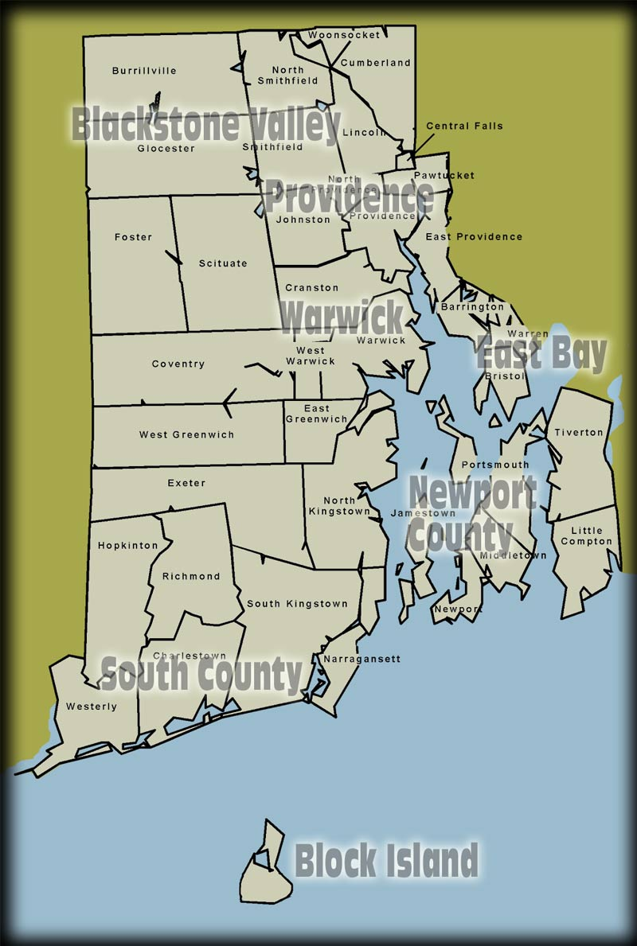
Regional Distribution of Tourism
Rhode Island is divided into eight regions in the analysis:
  Blackstone Valley
    Burrillville
    Central Falls
    Cumberland
    Glocester
    Lincoln
    North Smithfield
    Pawtucket
    Smithfield
    Woonsocket
  Providence
    Providence
    East Providence
  Warwick
    Warwick
  Block Island
    Block Island
  Balance of State
    Cranston
    Foster
    Johnston
    North Providence
    Scituate
    West Warwick
  Newport County
    Little Compton
    Middletown
    Newport
    Portsmouth
    Tiverton
    Jamestown
  South County
    Charlestown
    Coventry
    East Greenwich
    Exeter
    Hopkinton
    Narragansett
    North Kingstown
    Richmond
    South Kingstown
    Westerly
    West Greenwich
  East Bay
    Barrington
    Bristol
    Warren

Slide 34
Regional TSA + Under 50Mile Expenditures
Regional Share of State Expenditures by Category ($M) - 2012
 | Accommodations | Entertainment | Food | Retail | Transportation | Total
Balance of State | 9.56 | 46.58 | 210.01 | 77.99 | 87.10 | 431.23
Blackstone Valley | 25.68 | 506.80 | 244.35 | 64.37 | 87.99 | 929.19
Block Island | 94.22 | 58.36 | 25.10 | 50.63 | 19.29 | 247.61
East Bay | 5.39 | 25.24 | 58.77 | 40.24 | 10.68 | 140.32
Newport | 232.33 | 185.88 | 237.45 | 87.41 | 46.24 | 789.30
Providence | 141.55 | 370.85 | 408.46 | 397.98 | 318.63 | 1,637.47
South County | 206.49 | 88.19 | 263.45 | 167.13 | 49.88 | 775.14
Warwick | 63.26 | 66.00 | 181.03 | 94.37 | 241.63 | 646.28
Total | 778.48 | 1,347.91 | 1,628.62 | 980.12 | 861.43 | 5,596.54
Entertainment data includes gaming, spectator sports boating and marina activity and other categories.

Slide 35
Regional TSA Tourism Expenditures
Regional Share of State Expenditures by Category ($M) - 2012
 | Accomodations | Entertainment | Food | Retail | Transportation | Total
Balance of State | 9.56 | 31.81 | 87.05 | 44.22 | 90.27 | 262.92
Blackstone Valley | 25.68 | 223.77 | 112.23 | 39.77 | 87.86 | 489.32
Block Island | 94.22 | 52.97 | 25.10 | 30.07 | 14.56 | 216.93
East Bay | 5.39 | 24.15 | 31.43 | 24.70 | 10.34 | 96.01
Newport | 232.33 | 122.26 | 107.29 | 53.04 | 29.89 | 544.80
Providence | 141.55 | 277.39 | 201.55 | 234.43 | 307.23 | 1,162.15
South County | 206.49 | 83.60 | 114.61 | 98.54 | 41.40 | 544.64
Warwick | 63.26 | 41.51 | 80.90 | 66.00 | 250.81 | 502.48
Total | 778.48 | 857.47 | 760.17 | 590.78 | 832.36 | 3,819.25
Accomodation data includes seasonal second home rentals, which creates significant differences in share from state room tax data. As the TSA definition of tourism includes any overnight stay, accomodations results are the same for TSA and TSA + Under 50Mile.

Slide 36
Regional Share of Statewide TSA + Under 50Mile Expenditures
Regional Share of State Expenditures by Category - 2012
 | Accommodation | Entertainment | Food | Shopping | Transportation | Total
Providence | 18.2% | 27.5% | 25.1% | 40.6% | 37.0% | 29.3%
Blackstone Valley | 3.3% | 37.6% | 15.0% | 6.6% | 10.2% | 16.6%
Newport | 29.8% | 13.8% | 14.6% | 8.9% | 5.4% | 14.1%
South County | 26.5% | 6.5% | 16.2% | 17.1% | 5.8% | 13.9%
Warwick | 8.1% | 4.9% | 11.1% | 9.6% | 28.0% | 11.5%
Balance of State | 1.2% | 3.5% | 12.9% | 8.0% | 10.1% | 7.7%
Block Island | 12.1% | 4.3% | 1.5% | 5.2% | 2.2% | 4.4%
East Bay | 0.7% | 1.9% | 3.6% | 4.1% | 1.2% | 2.5%
Total | 100.0% | 100.0% | 100.0% | 100.0% | 100.0% | 100.0%
Entertainment data includes gaming, spectator sports boating and marina activity and other categories.

Slide 37
Regional Share of Statewide TSA + Under 50Mile Expenditures
Expenditure Category Share of Regional Tourism Spending - 2012
 | Accommodation | Entertainment | Food | Shopping | Transportation | Total
Providence | 8.6% | 22.6% | 24.9% | 24.3% | 19.5% | 100.0%
Blackstone Valley | 2.8% | 54.5% | 26.3% | 6.9% | 9.5% | 100.0%
Newport | 29.4% | 23.5% | 30.1% | 11.1% | 5.9% | 100.0%
South County | 26.6% | 11.4% | 34.0% | 21.6% | 6.4% | 100.0%
Warwick | 9.8% | 10.2% | 28.0% | 14.6% | 37.4% | 100.0%
Balance of State | 2.2% | 10.8% | 48.7% | 18.1% | 20.2% | 100.0%
East Bay | 3.8% | 18.0% | 41.9% | 28.7% | 7.6% | 100.0%
Block Island | 38.1% | 23.6% | 10.1% | 20.4% | 7.8% | 100.0%
Grand Total | 13.9% | 24.1% | 29.1% | 17.5% | 15.4% | 100.0%
Warwick’s Transportation share is very high as TF Green Airport revenue is counted here.

Slide 38
Regional Share of Statewide TSA Tourism
Regional Share of State Expenditures by Category - 2012
 | Accommodation | Entertainment | Food | Shopping | Transportation | Total
Providence | 18.2% | 32.3% | 26.5% | 39.7% | 36.9% | 30.4%
Newport | 29.8% | 14.3% | 14.1% | 9.0% | 3.6% | 14.3%
South County | 26.5% | 9.7% | 15.1% | 16.7% | 5.0% | 14.3%
Warwick | 8.1% | 4.8% | 10.6% | 11.2% | 30.1% | 13.2%
Blackstone Valley | 3.3% | 26.1% | 14.8% | 6.7% | 10.6% | 12.8%
Balance of State | 1.2% | 3.7% | 11.5% | 7.5% | 10.8% | 6.9%
Block Island | 12.1% | 6.2% | 3.3% | 5.1% | 1.7% | 5.7%
East Bay | 0.7% | 2.8% | 4.1% | 4.2% | 1.2% | 2.5%
Total | 100% | 100% | 100% | 100% | 100% | 100%
Accomodation data includes seasonal second home rentals, which creates significant differences in share from state room tax data. As the TSA definition of tourism includes any overnight stay, accomodations results are the same for TSA and TSA + Under 50Mile.

Slide 39
Regional Share of Statewide TSA Tourism
Expenditure Category Share of Regional Tourism Spending - 2012
 | Accommodation | Entertainment | Food | Shopping | Transportation | Total
Providence | 12.2% | 23.9% | 17.3% | 20.2% | 26.4% | 100.0%
Newport | 42.6% | 22.4% | 19.7% | 9.7% | 5.5% | 100.0%
South County | 37.9% | 15.3% | 21.0% | 18.1% | 7.6% | 100.0%
Warwick | 12.6% | 8.3% | 16.1% | 13.1% | 49.9% | 100.0%
Blackstone Valley | 5.2% | 45.7% | 22.9% | 8.1% | 18.0% | 100.0%
Balance of State | 3.6% | 12.1% | 33.1% | 16.8% | 34.3% | 100.0%
Block Island | 43.4% | 24.4% | 11.6% | 13.9% | 6.7% | 100.0%
East Bay | 5.6% | 25.2% | 32.7% | 25.7% | 10.8% | 100.0%
Grand Total | 20.4% | 22.5% | 19.9% | 15.5% | 21.8% | 100.0%
Warwick’s Transportation share is very high as TF Green Airport revenue is counted here.

Slide 40
TSA + Under 50Mile Growth Rates by Region for 2012
Regional Growth Rates by Category 2011 vs. 2012
 | Accomodation | Entertainment | Food | Retail | Transportation | Grand Total
Balance of State | -0.3% | 1.0% | 5.2% | 6.7% | 1.3% | 4.1%
Blackstone Valley | 7.0% | 0.7% | 5.0% | 6.2% | 1.6% | 2.4%
Block Island | 4.6% | -0.7% | 9.4% | 8.0% | 3.0% | 4.3%
East Bay | -0.2% | 3.0% | 3.9% | 6.0% | -0.8% | 3.8%
Newport | 3.3% | -1.0% | 5.6% | 9.1% | 3.1% | 3.5%
Providence | 4.9% | 1.5% | 7.2% | 6.8% | 1.0% | 4.3%
South County | 2.7% | -1.1% | 6.4% | 7.7% | 2.6% | 4.5%
Warwick | 5.3% | -1.2% | 4.5% | 9.1% | 0.5% | 3.1%
Grand Total | 3.8% | 0.5% | 5.9% | 7.4% | 1.2% | 3.7%
Entertainment and Transportation saw only modest gains in spending during 2012.

Slide 41
TSA Tourism Growth Rates by Region for 2012
Regional Growth Rates by Category 2011 vs. 2012
 | Accommodation | Entertainment | Food | Retail | Transportation | Grand Total
Balance of State | -0.3% | -0.8% | 3.7% | 7.1% | 1.3% | 2.7%
Blackstone Valley | 7.0% | 0.6% | 4.2% | 8.0% | 1.9% | 2.6%
Block Island | 4.6% | -0.6% | 7.8% | 8.4% | 2.3% | 4.0%
East Bay | -0.2% | 1.9% | 2.8% | 5.7% | -1.3% | 2.7%
Newport | 3.3% | -0.1% | 4.8% | 9.0% | 2.2% | 3.2%
Providence | 4.9% | 1.1% | 4.7% | 8.2% | 1.5% | 3.6%
South County | 2.7% | -0.5% | 5.6% | 8.1% | 2.5% | 3.7%
Warwick | 5.3% | 1.6% | 3.2% | 7.6% | 0.0% | 2.2%
Total | 3.8% | 0.5% | 4.5% | 8.0% | 1.1% | 3.2%
Retail spending at TSA level only category to outpace growth seen in TSA+Under 50Mile

Slide 42
Regional Share of Statewide TSA + Under 50Mile Visitation
Regional Share of State Visitors - 2012
 | Share of Expenditures | Share of Visitation | Total Visitors (000)
Balance of State | 7.7% | 7.3% | 1,339.8
Blackstone Valley | 16.6% | 19.7% | 3,631.4
Block Island | 4.4% | 3.2% | 596.2
East Bay | 2.5% | 2.9% | 533.0
Newport | 14.1% | 16.1% | 2,967.9
Providence | 29.3% | 29.3% | 5,401.8
South County | 13.9% | 12.8% | 2,366.0
Warwick | 11.5% | 8.7% | 1,612.2
Total | 100.0% | 100.0% | 18,448.3
Biggest variances from spending shares are in regions where there is a dominant category, such as entertainment in Blackstone Valley or high transportation revenue in Warwick

Slide 43
Regional Share of Statewide TSA Tourism Visitation
Regional Share of State Visitors - 2012
 | Share of Expenditures | Share of Visitation | Total Visitors (000)
Balance of State | 6.9% | 8.1% | 633.6
Blackstone Valley | 12.8% | 18.1% | 1,416.6
Block Island | 5.7% | 5.8% | 455.8
East Bay | 2.5% | 4.1% | 323.2
Newport | 14.3% | 16.6% | 1,301.4
Providence | 30.4% | 35.4% | 2,773.0
South County | 14.3% | 14.0% | 1,098.8
Warwick | 13.2% | 9.8% | 767.6
Total | 100.0% | 112.0% | 8,770.0
Biggest variances from spending shares are in regions where there is a dominant category, such as entertainment in Blackstone Valley or high transportation revenue in Warwick

Slide 44
Regional Growth in Expenditures 2011 - 2012
TSA Only
TSA + <50Mile
All tourism regions within the state are benefitting from the growth within tourism.

Slide 45
New England and Rhode Island Economic Overview

Slide 46
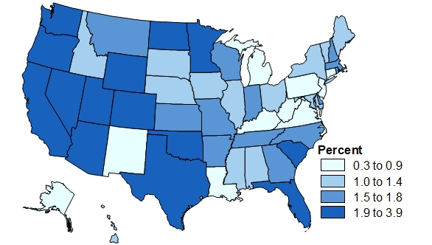
Employment Situation
Employment Growth 2014Q2 (Percent change year ago)
Source: IHS
The unemployment rate for New England dropped to 6.3% in March, which was slightly below the national rate of 6.7%.
Rhode Island’s unemployment rate stood at 8.7% in March, the lowest it had been since September 2008.
Employment in Leisure and Hospitality in RI surpassed its 2007 peak in 2012.

Slide 47
Economic Recovery Will Pick Up Steam Going Forward
Annual Economic Growth for NE and RI
Source: IHS; based on nominal dollars
The economic recovery gained momentum in 2010 and maintained strong growth through 2012. Growth in New England and Rhode Island will be slower going forward.
Rhode Island’s L&H industry surpassed its 2007 peak in 2010.

Slide 48
Talking Points: What Do Visitors Mean to RI?
Talking Points: What Do Visitors Mean to RI?
  If tourism didn’t exist, each household would pay $1,524 more in taxes to maintain the current level of state and local tax receipts
  Each visitor creates about $121 in tax receipts, $74 of which goes to state & local authorities
  It takes only 213 visitors to pay for one Rhode Island public school student for one year
  Each RI visitor/traveler generates about $435 in expenditures, $38 of which goes to RI businesses that do not directly “touch” that visitor
  Every 204 visitors creates a new RI job
  Each visitor adds about $257 to RI Gross State Product

Slide 49
IHS Consulting
Leveraging the company’s full suite of data, intelligence & expertise
Shane Norton
IHS Economics and Country Risk
781.301.9071
shane.norton@ihs.com

