Slide 1

Rhode Island and US Tourism:
Finally, Some Good News
November 8, 2011

Slide 2
Agenda
Quick Introduction to IHS Global Insight
What is Tourism Satellite Accounting?
2010 Rhode Island Tourism Results
What Do Visitors Mean to RI?
Outlook for Travel

Slide 3
About IHS Global Insight:
Premier economic analysis, forecasting, & consulting organization
Formed in 2001 by combining WEFA and DRI
Provides the most comprehensive coverage of countries, regions and industries available from any single source
Brings a common analytical framework and a consistent set of assumptions to diverse capabilities and products
Significant Travel & Tourism practice, with major public and private clients
We are now part of IHS, an $900B publicly traded information company
Provides a broad range of consulting capabilities covering:
Strong reputation and experience within the travel & tourism sector
Market Analysis | Business Planning
Investment Strategy | Risk Assessment
Infrastructure Analysis | Policy Evaluation
Economic Development | Economic Impact

Slide 4
Travel and Tourism Expertise
Visitation & Spending Forecasts –by category and by country, region, state, or U.S. city. Market size, growth, and share.
Market Feasibility & Investment Facilitation market analysis & research, demand/supply review, policy evaluation, development cost analysis.
Destination Impact & Concession Support economic impact of the construction and operations of individual facilities –resort, convention center, entertainment venue, event…
Tourism Economic Impact & Tourism Satellite Accounting conforming to the UN/WTO standards. What does travel & tourism contribute in jobs, wages, spending, and taxes to a national or local economy?
Tourism Policy Analysis travel & tourism policy evaluation and rationalization.

Slide 5
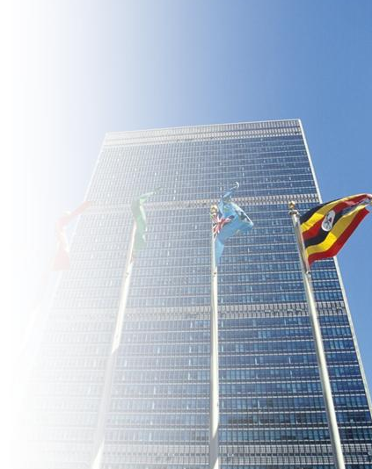
Tourism Satellite Accounting
The Tourism Satellite Account is the international (UN/WTO, OECD) standard for measuring the contribution of tourism to an economy
Measuring the industry “tourism” is difficult:
  Tourism is not measured in standard economic accounting terms.
  Most industries are accounted via the supply-side:
  firms are categorized into NAICS codes and
  asked about jobs, revenues, costs.
  But tourism is a demand-side activity:
  the focus is on what the traveler buys before and
  during a trip( hotel, food, transportation, retail…).
  As a result, tourism touches many industries
Why a TSA? -the 4”Cs”: Credibility, Comprehensiveness, Comparability, Consistency
5

Slide 6

Benefits of a TSA
Are we spending enough on tourism promotion and infrastructure? Compares government support of the tourism sector with government revenue generated by tourism.
Which are our best economic development targets and are candidate-requested concessions worth it? Allows policy-makers to compare the size & growth of tourism to other industrial sectors.
What is the ROI of public tourism investment? Enables analysts to assess long-term health of the tourism sector vis-a-vis capital investment and govt. support.
How can we benchmark ourselves against our destination competition? Provides an accepted international standard for benchmarking.
How can we communicate the full value of tourism to policy makers, businesses, and citizens? Quantifies how other industries benefit from tourism.
6

Slide 7
TSA and Tourism Economic Impact Client Examples
Tourism Satellite Account
  RHODE ISLAND
  North Dakota
  New Jersey
  Bahamas
  Delaware
  Maryland
  Israel
  Dubai
  Abu Dhabi
  South Dakota
  Kansas
  Guam
  North Carolina
  Alaska
  South Carolina
  Virginia
  Utah
Economic Impact
  Idaho
  Pennsylvania
  Indiana
City Tourism Impact
Washington, DC
NYC
Dallas
Boston
Arlington, TX
Sacramento
Baltimore
Philadelphia
Orlando
Meadowlands
Tulsa
St. Louis
Kansas City
Battle Creek
Durham, NC
Savannah
Pittsburgh
Austin
Indianapolis
Omaha

Slide 8
Tourism Economic Impact: Definitions
Visitor: GT 50 miles, non-commuting; All overnight trips
Resident Tourism: Outbound purchases made in advance of a trip only. Resident usage of RI tourism assets are not included.
Tourism Expenditures: A TSA concept, includes all spending by all constituents on travel made in the state (RI), including tourism related investments
Visitor Spending: Spending in the jurisdiction by visitors (see above) (on accommodations, food & beverage, shopping, transportation, entertainment,…
Economic Impact: “GDP” definition…spending less value of supply chain purchases made outside RI. The amount retained in the RI economy.
Import Leakages: The value of supply chain purchases made outside of RI.
Direct Spending/Jobs/Wages/Taxes: Industries that “touch” the visitor (e.g. hotels, restaurants, museums,…)
Indirect Spending/Jobs/Wages/Taxes: Industries that supply those that touch the visitor
Induced Spending/Jobs/Wages/Taxes: Workers of industries that touch or supply spend their wages locally
Core Impact: Impact results based purely off of visitor expenditures
Total Impact: Impact results Include investment, government support, and expenditures

Slide 9
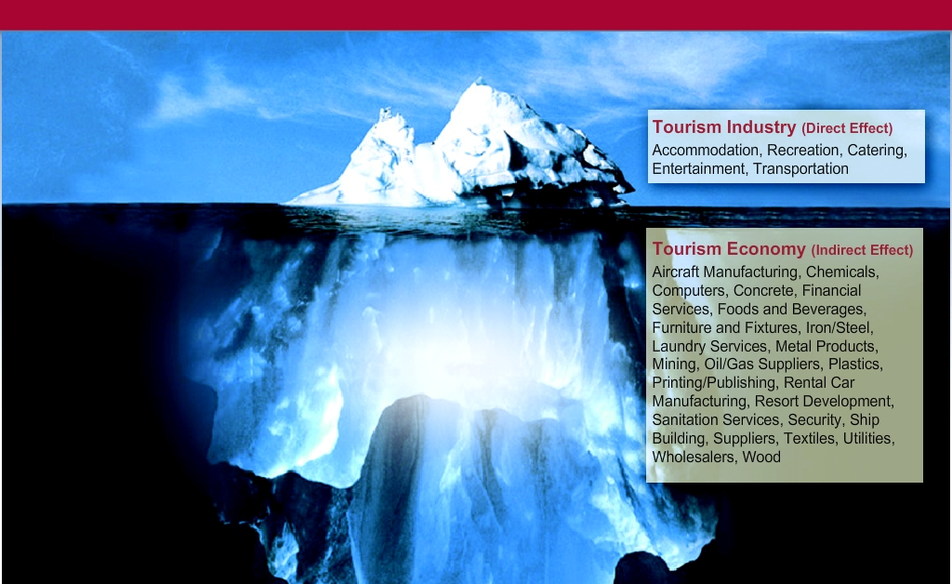
T&T Industry and Economy
Travel & Tourism Industry
The direct effect of travel demand
Travel & Tourism Economy
The flow-through effect of travel demand across the economy
Travel & Tourism Economy
The TSA provides both a narrow & a broad understanding of the Tourism “Industry”

Slide 10
Rhode Island Tourism Economic Impact - Definitions
TSA: Results (spending, economic impact, jobs,…) conform strictly to the TSA definition (e.g. 50mile+overnight visitor definition).
TSA + Under 50 Mile: TSA results, plus those coming from visitors traveling less than the 50 mile threshold. This classification is both historically consistent with previous studies and arguably more applicable to Rhode Island.
Approach
Total Impact: Total economic contribution of tourism to Rhode Island. Sum of core and non-core.
Core Impact: Economic contribution of from industries directly providing goods and services to the visitor.
Non-core Impact: Economic contribution from industries providing goods and services to core tourism providers. Also includes tourism investment.
Impact Sources

Slide 11
2010 Rhode Island Tourism Results

Slide 12
State Overview: 2010 Totals At A Glance
Tourism Concept | TSA + Under 50 Mile Visitors | TSA | TSA ’09 – ’10 Growth
Visits | 17.49 M | 7.83 M | 13.9%
Expenditures | $5.22 B | $3.56 B | 2.8%
Total Economic Impact | $3.36 B | $2.37 B | 2.3%
Core Economic Impact (GSP) | $2.32 | $1.64 B | 1.2%
Total Jobs | 65,925 | 41,932 | -0.7%
Wages | $1.95 B | $1.32 B | 2.1%
Taxes | $1,447 M | $930 M | 0.0%
Source: IHS Global Insight

Slide 13
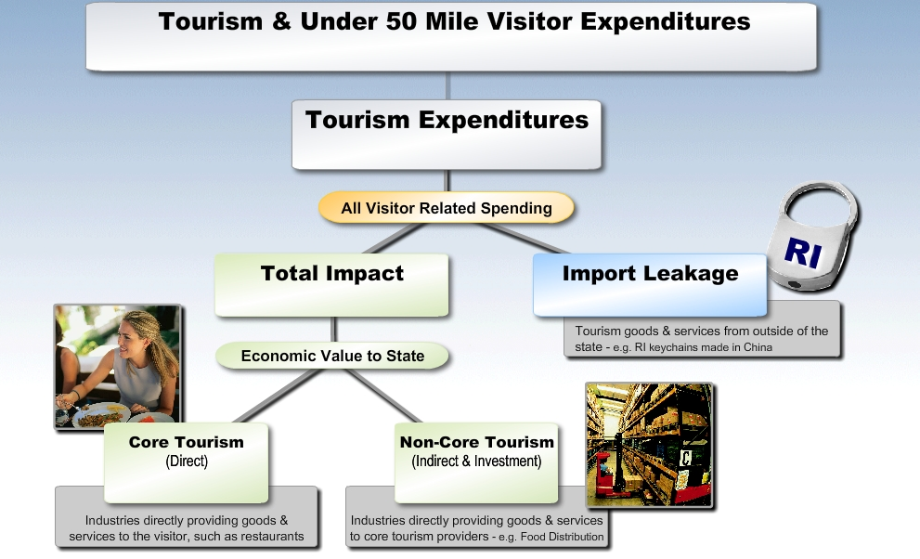
Industry Structure: Definitions
$5.22 billion
$3.56 billion
$2.37 billion
$1.19 billion
$1.64 billion
$724 million
Source: IHS Global Insight
13

Slide 14
State Overview: Tourism and Under 50Mile Visitors – 2010 vs. 2009
Measurement | 2010 | 2009 | Definition
Tourism (TSA) + Under 50Mile Visitor Spending | $5.22B | $5.07B | Spending from all tourism factors
Tourism Expenditures (TSA) | $3.56B | $3.47B | TSA Definition of State Tourism
Under 50Mile Visitors | $1.66B | $1.61B | Spending by visitors from less than 50 miles that utilize RI tourism assets
Tourism + Under 50Mile Visitors Total Employment* | 65,925 | 66,303 | Employment required to support core RI tourism activity
Core Tourism (TSA) Employment* | 32,986 | 33,181 | TSA Definition of Tourism “Industry”
Source: IHS Global Insight
Employment figures taken from a top down review of the total spending, creating a resultant number of jobs, both full-time and part-time
required to support that spending.

Slide 15

Why Are the 2009 Figures Revised From Last Year?
Key Measurements | 2009 Original TSA | 2009 Recast TSA
RI Expenditures ($B) | $3.40 | $3.47
Economic Value Core Tourism Total Impact | $1.62 $2.31 | $1.62 $2.34
Wages & Salaries Core Tourism Total Impact | $.845 $1.28 | $.851 $1.29
Employment (‘000) Core Tourism Total Impact | 33.27 42.16 | 33.18 42.25
Taxes –Total Impact | $921 M | $930 M
Each year revisions to most of the historical tourism metrics must be made in order to reflect:
Finalization of the annual visitor spending data from DKSA.
Revisions to the BLS and BEA inputs covering employment, Gross State Product, Sales Output, and Payroll for all industries at the jurisdiction county level.
New Baseline Data for IMPLAN interindustry model incorporating latest Census data
Source: IHS Global Insight

Slide 16
Total Tourism (TSA) Expenditures
RI visitation increased by 13.9% in ‘10
Spending per visit fell by 9.5% in ‘10
Visitor spending grew 2.8% ’10
Investment spending fell 7.6% in ‘10
Tourism expenditures tallied $3.6 billion in 2010
Source: IHS Global Insight

Slide 17
Visitors to Rhode Island*
Total visitors increased 13.9% in 2010; total visitors now just 0.5% off 2007 peak.
* Visitors from GT 50 miles or overnight only, provided by DK Shifflet & Associates, Ltd. Leisure and Business travel results were estimated by IGI.

Slide 18
Finally, Some Positive Numbers
Measurement | 2009 (billions) | 2010 (billions) | 2009-2010 growth
Tourism (TSA) + Under 50Mile Visitor Expenditures | $5.072 | $5.224 | 3.0%
Tourism (TSA) Expenditures | $3.465 | $3.562 | 2.8%
Total Economic Impact | $2.336 | $2.367 | 1.3%
Core Tourism (direct) | $1.623 | $1.643 | 1.2%
Non-Core Tourism | $0.757 | $0.767 | 1.2%
Import Leakage | $1.129 | $1.194 | 5.8%
Tourism Expenditures experienced positive growth for the first time since 2008, driving its economic impact up to the positive ground.
Source: IHS Global Insight

Slide 19
Tourism Remains Acutely Affected By Recession…
2010 TSA Bottom Line:
Measurement | 2010 | 2009 | % | Perspective
Economic Value ($B) Core Tourism Total Impact | $1.64 $2.37 | $1.62 $2.34 | 1.2% 1.3% | Driven by the economic recovery, the tourism sector experienced moderate positive growth for the first time since 2008.
Wages & Salaries Core Tourism ($M) Total Impact ($M) | $872 $1,321 | $851 $1,294 | 2.5% 2.1% | Average annual salary grew 3.1% and 2.9% for Core and Total Tourism, respectively
Employment (‘000) Core Tourism Total Impact | 32.99 41.93 | 33.18 42.25 | -0.6% -0.7% | Core tourism remains the 4th largest industry in RI
Taxes –Total Impact ($M) | $930 | $930 | -0.03% | If tourism didn’t exist, each household would pay an additional $1,310 in taxes to maintain current tax receipts.
Numbers may differ due to rounding
Source: IHS Global Insight

Slide 20
Total Impact of Tourism
In 2010, the total economic impact of travel & tourism (direct and indirect) was $2.37 billion. This represents 5.0% of RI Gross State Product
The ratio of the total impact to total expenditures reveals that 67¢ of each tourism dollar spent in Rhode Island is retained in the state. The remainder represents import leakages. This share is fairly typical for a diversified state like Rhode Island and higher than many other states.
Over 41,900 jobs – direct and indirect – were created by travel & tourism (TSA) economic activity. This accounts for 9.3% of total employment in RI.
$1.32 billion in wages & salaries were generated by travel & tourism (TSA) in 2010.
Tourism (TSA) generated $930 million in federal, state, and local government taxes in 2010, with the state and local tax contribution making up 8.4% of all RI state gov. revenue.

Slide 21

Sources of Tourism Expenditures
Visitor Spending – Expenditures by visitors who have come from greater than 50 miles or stayed overnight
Business Travel – Businesses’ spending within the state economy on travel
Resident Outbound – Resident spending preparing for an out-of-state trip
Government Spending – Tourism Office Budgets, transportation functions related to tourism, publicly funded attractions and funding for security in tourism-intensive areas
Investment – Construction of hotels, attractions, tourism infrastructure, operating and transportation equipment
International – Spending of international visitors within the state
Under 50Mile Visitors – Spending by residents or non-residents who have come from under 50 miles. No commuters or local utilization. Not included in TSA definition.

Slide 22
Breaking Down Tourism Expenditures – $3.56 Billion
Only 8% of TSA Expenditures in Rhode Island come from outside of visitor spending, while in 2007 that share was 16%. The primary source of that change is the 3 year collapse in investment spending.
 | Million $ | Share Of Total | ’09 – ’10 Growth
Investment | 89 | 2.5% | -7.6%
Visitors | 3,284 | 92.2% | 2.3%
Other | 188 | 5.3% | 19.2%
Total | 3,562 | 100% | 2.8%
Source: IHS Global Insight

Slide 23
Category Distribution of Expenditures
In 2010, all categories except entertainment saw a growth in visitor spending, with retail spending growth of 6.7% leading the way. Visitor spending has now surpassed 2008’s total, and is just 4.3% below 2007’s historical peak.
 | 2010 <50Mile Million $ | 2010 TSA Million $ | TSA ‘09 – ‘10 Growth
Entertainment** | 1,268 | 780 | -1.1%
Accommodation | 684 | 684 | 0.1%
Transportation | 833 | 815 | 6.7%
Food | 1,484 | 693 | 4.2%
Shopping | 865 | 501 | 6.7%
Total * | 5,134 | 3,473 | 3.1%
TSA Shares
* Direct and Indirect Tourism Expenditures (w/o construction & investment)
Source: IHS Global Insight
** Entertainment category includes all marina and boating activity

Slide 24
Entertainment Spending Detail - TSA + Under 50Mile
The Entertainment category includes a wide array of industries, from gaming to recreation sports to movies. Total Entertainment spending grew 0.6% in 2010.
 | 2010 ($000) | 2009 ($000)
Amusement Parks & Arcades | 4,522 | 4,479
Gambling Industries | 477,100 | 461,200
Independent Artists. Writers, & Performers | 11,195 | 10,063
Motion Picture & Video Industries | 136,023 | 133,163
Museums & Historical Sites | 63,960 | 67,731
Other Amusement & Rec. Services** | 393,922 | 402,092
Performing Arts Companies | 75,307 | 73,440
Spectator Sports | 106,282 | 108,716
Total Entertainment Spending | 1,268,315 | 1,260,888
Source: IHS Global Insight
** NAICS 7139 – Other Amusement & Rec. Services – includes both golf and marina activity

Slide 25
Transportation Detail - TSA + Under 50Mile
Total Transportation spending grew 2.9% in 2010.
 | 2010($000) | 2009($000)
Automotive Equipment Rental and Leasing | 408,809 | 357,335
Charter Bus Industry | 12,364 | 12,358
Nonscheduled Air Transportation | 260 | 231
Rail Transportation | 1,444 | 1,109
Scenic & Sightseeing Transportation | 13,725 | 13,368
Scheduled Air Transportation | 27,854 | 25,909
Taxi & limousine Service | 10,784 | 10,443
Travel Arrangement & Reservation Ser. | 306,436 | 306,019
Other Transportation | 16,247 | 14,784
Transportation Total* | 797,926 | 741,559
Source: IHS Global Insight
* Transportation figures here exclude resident outbound spending

Slide 26

Core Tourism
Answers the question “How does tourism compare with other industries?”
Core Tourism measures the size of the industry directly providing goods & services to the visitor.
Indirect effects are excluded – these are part of other supplier industries such as wholesalers. The impact of capital investment is also excluded.
Core Tourism generated $1.6 billion in economic value in 2010. This ranks core tourism as the 10th largest private industry in RI in terms of Gross State Product.

Slide 27
Core Tourism – Gross State Product
Core Tourism contributed $1.64 billion in economic value in 2010.
Tourism ranked as the 10th largest private industry in Rhode Island.
Rank | Industry | Millions $ | ’09-’10 Growth | % of State
1 | Real Estate and Rental and Leasing | 7,083 | -1.8% | 16.3%
2 | Finance and Insurance | 6,377 | 8.4% | 14.7%
3 | Health Care and Social Assistance | 5,077 | 5.3% | 11.7%
4 | Professional, Scientific, and Technical Services | 2,950 | 2.6% | 6.8%
5 | Retail Trade | 2,713 | 6.2% | 6.2%
6 | Durables Manufacturing | 2,679 | 10.2% | 6.2%
7 | Wholesale Trade | 2,442 | 6.9% | 5.6%
8 | Information | 1,998 | 4.4% | 4.6%
9 | Construction | 1,873 | -5.5% | 4.3%
10 | Accommodation and Food Services | 1,464 | 4.4% | 3.4%
11 | Educational Services | 1,359 | 4.5% | 3.1%
12 | Non-Durables Manufacturing | 1,249 | 5.1% | 2.9%
13 | Admin., Support and Waste Management | 1,178 | 6.7% | 2.7%
14 | Management of Companies and Enterprises | 1,162 | 2.0% | 2.7%
15 | Utilities | 865 | 4.7% | 2.0%
 | Other Industries | 2,989 | 3.3% | 6.9%
 | Total Private | 43,457 | 3.9% | 100.0%
 | Government | 5,776 | 2.1%
Core Travel & Tourism would have 3.8% of Rhode Island’s GSP
 | Travel & Tourism | 1,643 | 1.2% | 3.8%
Source: Bureau of Economic Analysis and IHS Global Insight

Slide 28
Core Tourism Impact – Composition
Transportation-related Sectors---namely Automotive Rental, and Gasoline Stations---have climbed on the back of the recovering number of visitation, and experienced significant growth in 2010.
Composition of Core Tourism
Rank | Industry | $ Value | ’09-’10 | % of
 |  | (Millions) | Growth | Total
1 | Food services and drinking places | 346 | 3.4% | 20.4%
2 | Other amusement and recreation industries | 266 | -2.0% | 15.7%
3 | Real estate establishments | 251 | -10.9% | 14.8%
4 | Hotels and motels, including casino hotels | 217 | 10.7% | 12.8%
5 | Automotive equipment rental and leasing | 190 | 13.2% | 11.2%
6 | Travel arrangement and reservation services | 177 | -1.4% | 10.4%
7 | Performing arts companies | 83 | 2.1% | 4.9%
8 | Retail Stores - Food and beverage | 28 | 2.9% | 1.7%
9 | Retail Stores - Clothing and clothing accessories | 28 | 2.9% | 1.6%
10 | Spectator sports companies | 23 | -3.3% | 1.4%
11 | Transport by air | 20 | -2.0% | 1.2%
12 | Retail Stores - Gasoline stations | 17 | 16.5% | 1.0%
13 | Scenic and sightseeing transportation | 12 | 1.8% | 0.7%
14 | Retail Stores - Miscellaneous | 11 | 2.9% | 0.7%
15 | Transit and ground passenger transportation | 11 | -0.9% | 0.6%
 | Other Industries | 17 | -0.9% | 1.0%
 | Total | 1,643 | 1.2% | 100.0%
Source: IHS Global Insight

Slide 29
Core Tourism – Employment
Core Tourism is the 4th largest private sector employer in Rhode Island with nearly 33,000 tourism supported jobs in 2010.
Core Tourism generated 8.3% of private employment in 2010.
Core Tourism jobs provided $872 million in wages & salaries in 2010.
Core Tourism’s average annual wage has grown from 25,400/year in 2009 to 26,400/year in 2010.

Slide 30
Ranking Core Tourism – Employment
Travel & tourism is RI’s 4th largest private sector employer.
Rank | Industry | Reported Employment (Thousands) | 2009-2010 Growth | % of State | Tourism-Extracted Employment (Thousands)
1 | Health Care and Social Assistance | 78.1 | 1.5% | 19.7% | 78.1
2 | Retail Trade | 47.0 | -0.2% | 11.9% | 44.9
3 | Accommodation and Food Services | 42.2 | 2.1% | 10.6% | 26.7
4 | Manufacturing, Durables | 25.7 | -4.2% | 6.5% | 25.7
5 | Finance and Insurance | 24.9 | -1.5% | 6.3% | 24.9
6 | Educational Services | 23.8 | -0.8% | 6.0% | 23.8
7 | Administrative and Waste Services | 23.1 | 3.8% | 5.8% | 22.2
8 | Other Services | 22.2 | -0.1% | 5.6% | 21.0
9 | Professional, Scientific, and Tech. Services | 20.7 | -1.6% | 5.2% | 20.7
10 | Wholesale Trade | 16.1 | 0.2% | 4.0% | 15.9
11 | Construction | 15.9 | -7.8% | 4.0% | 16.1
12 | Manufacturing, Nondurables | 14.6 | -1.9% | 3.7% | 14.6
13 | Transportation and Warehousing | 10.2 | 0.0% | 2.6% | 10.1
14 | Information | 10.1 | -0.6% | 2.5% | 9.4
15 | Management of Companies and Enterprises | 9.3 | 0.8% | 2.3% | 9.3
 | Other Industries | 13.3 | -3.9% | 3.3% | 0.9
 | Total Nonfarm | 397.0 | -0.3% | 100% | 364.0
 | Government | 61.8 | -0.5% |  | 61.8
Core Tourism represented 32,986 jobs in 2010.
 | Travel & Tourism | 33.0 | -0.6% | 8.3% | 33.0
Source: Bureau of Labor Statistics and IHS Global Insight

Slide 31
Total Rhode Island Tourism Employment fell marginally by 0.7% in 2010
Core Tourism jobs comprise 79% of total tourism-generated employment.
Total
Impact
Core
Tourism
Source: IHS Global Insight

Slide 32
Non-Core Tourism – Indirect Benefits
Excluding Investment, non-core tourism grew 2.4% in 2010
Indirect Benefits of Tourism
Rank | Industry | $ Value | ’09-’10 | % of
 |  | (Millions) | Growth | Total
1 | Real estate establishments | 99 | 0.4% | 13.0%
2 | Management of companies and enterprises | 51 | 5.2% | 6.7%
3 | Wholesale trade businesses | 38 | 3.5% | 5.0%
4 | Monetary authorities and depository credit firms | 33 | 1.2% | 4.4%
5 | Electric power generation, transmission, and distribution | 34 | 4.6% | 4.5%
6 | Telecommunications | 27 | 2.2% | 3.5%
7 | Insurance carriers | 27 | 2.5% | 3.5%
8 | Employment services | 21 | 1.3% | 2.8%
9 | Food services and drinking places | 21 | 3.1% | 2.8%
10 | Services to buildings and dwellings | 18 | 2.3% | 2.4%
11 | Accounting, tax preparation and bookkeeping services | 18 | 1.9% | 2.3%
12 | Legal services | 15 | 1.3% | 2.0%
13 | US Postal Service | 12 | 4.4% | 1.6%
14 | Other state and local government enterprises | 12 | 2.5% | 1.5%
15 | Radio and television broadcasting | 11 | 3.3% | 1.5%
 | Other Industries | 238 | 2.4% | 31.0%
 | Investment | 89 | -6.7% | 11.7%
 | Total | 767 | 1.2% | 100.0%
Source: IHS Global Insight

Slide 33
Non-Core Tourism – Construction Benefits
The increase in private investment was more than offset by a decline in stimulus driven public spending
Source: FW Dodge
Data is “Value of Construction Contracts”, measuring the value of government and private construction at the time when work begins, encompassing total value for entire projects which start or break ground in a given year, excluding ancillary costs such as land acquisition.

Slide 34
Tourism Generated $930M in Total Tax Revenue in 2010
Tourism activity generated $541 million in state and local government revenue in 2010, a 0.3% decrease over 2009.
In 2010, $374 million in state tax revenue was generated by the travel & tourism sector in Rhode Island. Indirect business tax (sales tax) and the gaming taxes are the two largest contributors.
Tourism contributes disproportionately to state & local tax revenue. While Total Tourism is responsible for 5.0% of total RI GSP, it contributed 8.4% of state government revenue in 2010.
If tourism didn’t exist, each RI household would pay $1,310 more in taxes to maintain the current level of state and local tax receipts.

Slide 35
State and Local Government Revenue
Tax Revenues from Tourism (TSA) | 2010 (Million) | ’09-’10 Growth
Federal Government
Corporate Profits Tax | 79.4 | -1.4%
Personal Income | 117.1 | -0.3%
Social Security & Other Taxes | 191.7 | -0.2%
Federal Total | 388.2 | -0.5%
State Government
Corporate Profits Tax | 12.8 | -1.9%
Personal Income | 37.3 | -0.3%
Sales | 115.4 | -0.4%
Licenses & Fees | 9.7 | -0.3%
Gaming Tax | 145.7 | 1.6%
Other Taxes | 45.0 | -1.3%
State Share of Occupancy Tax* | 8.4 | 10.1%
State Total | 374.3 | 0.4%
Local Government
Local Share of Occupancy Taxes | 7.4 | 10.1%
Property Taxes | 159.8 | -0.4%
Local Total | 167.2 | 0.0%
Total | 929.7 | 0.0%
Source: IHS Global Insight
* Remainder of Room Tax not distributed back to local towns and cities.

Slide 36

How Important?
Gross State Product: $3.36 billion
        7.0 % of GSP
Total Employment: 65,925 jobs
14.6% of Employment
Gross State Product: $2.37 billion
        5.0% of GSP
Total Employment: 41,932 jobs
9.3% of Employment
Core GSP: $1.64 billion
3.4% of GSP
Core Employment: 32,986 jobs
7.3% of Employment
TSA + UNDER 50MILE VISITORS
Total Tourism-related spending of
$5.22 billion
TOTAL TSA
TOTAL TSA
CORE TOURISM
CORE TOURISM
% shown are for total state GSP, including Government

Slide 37
2010 Rhode Island Tourism
Regional Analysis

Slide 38
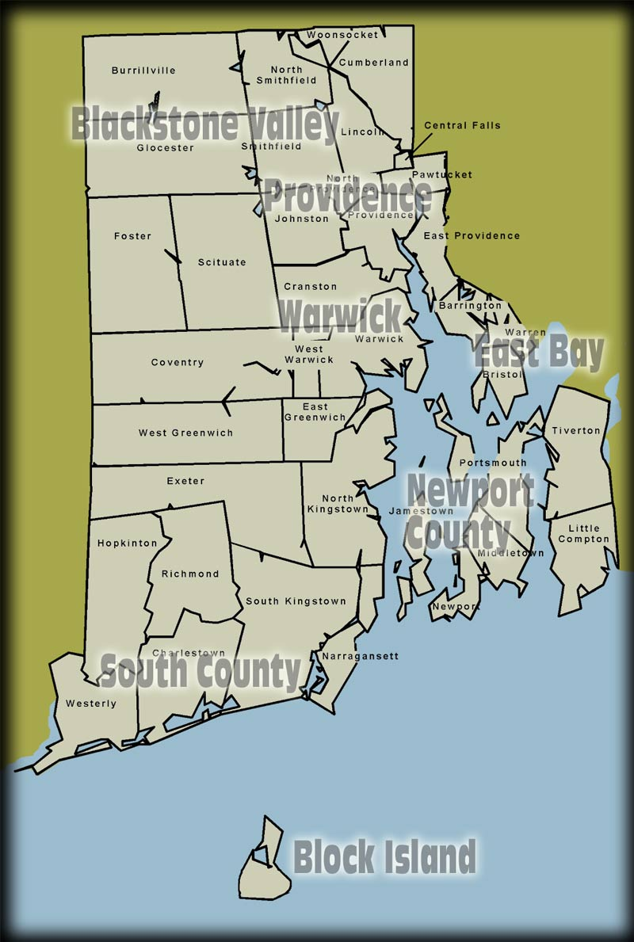
Regional Distribution of Tourism
Rhode Island is divided into eight regions in the analysis:
  Blackstone Valley
    Burrillville
    Central Falls
    Cumberland
    Glocester
    Lincoln
    North Smithfield
    Pawtucket
    Smithfield
    Woonsocket
  Providence
    Providence
  Warwick
    Warwick
  Block Island
    Block Island
  Balance of State
    Cranston
    Foster
    Johnston
    North Providence
    Scituate
    West Warwick
  Newport County
    Little Compton
    Middletown
    Newport
    Portsmouth
    Tiverton
    Jamestown
  South County
    Charlestown
    Coventry
    East Greenwich
    Exeter
    Hopkinton
    Narragansett
    North Kingstown
    Richmond
    South Kingstown
    Westerly
    West Greenwich
  East Bay
    Barrington
    Bristol
    East Providence
    Warren

Slide 39
Regional TSA + Under 50Mile Expenditures
Regional Share of State Expenditures by Category ($M)
 | Accommodations | Entertainment | Food | Retail | Transportation | Total
Balance of State | 9.50 | 43.57 | 194.04 | 69.41 | 84.13 | 400.86
Blackstone Valley | 21.96 | 472.43 | 227.12 | 56.44 | 84.75 | 862.70
Block Island | 76.34 | 53.65 | 21.83 | 44.58 | 18.32 | 214.72
East Bay | 5.09 | 37.33 | 104.34 | 44.80 | 46.90 | 238.53
Newport | 204.67 | 172.32 | 216.98 | 74.17 | 43.79 | 711.67
Providence | 127.05 | 341.00 | 313.09 | 343.19 | 272.11 | 1,396.45
South County | 182.57 | 82.35 | 238.14 | 147.53 | 47.56 | 698.16
Warwick | 57.25 | 65.66 | 168.52 | 84.55 | 235.39 | 611.36
Total | 684.44 | 1,268.32 | 1,484.06 | 864.67 | 832.96 | 5,134.44
Entertainment data includes gaming, spectator sports boating and marina activity and other categories.

Slide 40
Regional TSA Tourism Expenditures
Regional Share of State Expenditures by Category ($M)
 | Accomodations | Entertainment | Food | Retail | Transportation | Total
Balance of State | 9.50 | 30.10 | 81.34 | 38.03 | 88.26 | 247.22
Blackstone Valley | 21.96 | 201.67 | 103.93 | 33.65 | 84.92 | 446.13
Block Island | 76.34 | 49.96 | 22.18 | 25.34 | 14.10 | 187.91
East Bay | 5.09 | 34.39 | 51.49 | 30.63 | 38.12 | 159.72
Newport | 204.67 | 112.09 | 95.55 | 43.05 | 28.95 | 484.31
Providence | 127.05 | 237.60 | 161.37 | 190.38 | 271.87 | 988.27
South County | 182.57 | 76.79 | 103.33 | 83.46 | 40.07 | 486.22
Warwick | 57.25 | 37.04 | 73.51 | 56.14 | 249.01 | 472.95
Total | 684.44 | 779.63 | 692.70 | 500.67 | 815.30 | 3,472.73
Accomodation data includes seasonal second home rentals, which creates significant differences in share from state room tax data. As the TSA definition of tourism includes any overnight stay, accomodations results are the same for TSA and TSA + Under 50Mile.

Slide 41
Regional Share of Statewide TSA + Under 50Mile Expenditures
Regional Share of State Expenditures by Category
 | Accommodation | Entertainment | Food | Shopping | Transportation | Total
Providence | 18.6% | 26.9% | 21.1% | 39.7% | 32.7% | 27.2%
Blackstone Valley | 3.2% | 37.2% | 15.3% | 6.5% | 10.2% | 16.8%
Newport Country | 29.9% | 13.6% | 14.6% | 8.6% | 5.3% | 13.9%
South County | 26.7% | 6.5% | 16.0% | 17.1% | 5.7% | 13.6%
Warwick | 8.4% | 5.2% | 11.4% | 9.8% | 28.3% | 11.9%
Balance of State | 1.4% | 3.4% | 13.1% | 8.0% | 10.1% | 7.8%
East Bay | 0.7% | 2.9% | 7.0% | 5.2% | 5.6% | 4.6%
Block Island | 11.2% | 4.2% | 1.5% | 5.2% | 2.2% | 4.2%
Total | 100.0% | 100.0% | 100.0% | 100.0% | 100.0% | 100.0%
Entertainment data includes gaming, spectator sports boating and marina activity and other categories.

Slide 42
Regional Share of Statewide TSA + Under 50Mile Expenditures
Expenditure Category Share of Regional Tourism Spending
 | Accommodation | Entertainment | Food | Shopping | Transportation | Total
Providence | 9.1% | 24.4% | 22.4% | 24.6% | 19.5% | 100.0%
Blackstone Valley | 2.5% | 54.8% | 26.3% | 6.5% | 9.8% | 100.0%
Newport Country | 28.7% | 24.2% | 30.5% | 10.4% | 6.2% | 100.0%
South County | 26.2% | 11.8% | 34.1% | 21.1% | 6.8% | 100.0%
Warwick | 9.4% | 10.7% | 27.6% | 13.8% | 38.5% | 100.0%
Balance of State | 2.4% | 10.9% | 48.4% | 17.3% | 21.0% | 100.0%
East Bay | 2.1% | 15.7% | 43.8% | 18.8% | 19.7% | 100.0%
Block Island | 35.6% | 25.0% | 10.2% | 20.8% | 8.5% | 100.0%
Grand Total | 13.3% | 24.7% | 28.9% | 16.8% | 16.2% | 100.0%
Warwick’s Transportation share is very high as TF Green Airport revenue is counted here.

Slide 43
Regional Share of Statewide TSA Tourism
Regional Share of State Expenditures by Category
 | Accommodation | Entertainment | Food | Shopping | Transportation | Total
Providence | 18.6% | 30.5% | 23.3% | 38.0% | 33.3% | 28.5%
South County | 26.7% | 9.8% | 14.9% | 16.7% | 4.9% | 14.0%
Newport Country | 29.9% | 14.4% | 13.8% | 8.6% | 3.6% | 13.9%
Warwick | 8.4% | 4.8% | 10.6% | 11.2% | 30.5% | 13.6%
Blackstone Valley | 3.2% | 25.9% | 15.0% | 6.7% | 10.4% | 12.8%
Balance of State | 1.4% | 3.9% | 11.7% | 7.6% | 10.8% | 7.1%
Block Island | 11.2% | 6.4% | 3.2% | 5.1% | 1.7% | 5.4%
East Bay | 0.7% | 4.4% | 7.4% | 6.1% | 4.7% | 4.6%
Total | 100% | 100% | 100% | 100% | 100% | 100%
Accomodation data includes seasonal second home rentals, which creates significant differences in share from state room tax data. As the TSA definition of tourism includes any overnight stay, accomodations results are the same for TSA and TSA + Under 50Mile.

Slide 44
Regional Share of Statewide TSA Tourism
Expenditure Category Share of Regional Tourism Spending
 | Accommodation | Entertainment | Food | Shopping | Transportation | Total
Providence | 12.9% | 24.0% | 16.3% | 19.3% | 27.5% | 100.0%
South County | 37.5% | 15.8% | 21.3% | 17.2% | 8.2% | 100.0%
Newport Country | 42.3% | 23.1% | 19.7% | 8.9% | 6.0% | 100.0%
Warwick | 12.1% | 7.8% | 15.5% | 11.9% | 52.7% | 100.0%
Blackstone Valley | 4.9% | 45.2% | 23.3% | 7.5% | 19.0% | 100.0%
Balance of State | 3.8% | 12.2% | 32.9% | 15.4% | 35.7% | 100.0%
Block Island | 40.6% | 26.6% | 11.8% | 13.5% | 7.5% | 100.0%
East Bay | 3.2% | 21.5% | 32.2% | 19.2% | 23.9% | 100.0%
Grand Total | 19.7% | 22.4% | 19.9% | 14.4% | 23.5% | 100.0%
Warwick’s Transportation share is very high as TF Green Airport revenue is counted here.

Slide 45
TSA + Under 50Mile Growth Rates by Region for 2010
Regional Growth Rates by Category 2010 vs 2009
 | Accomodation | Entertainment | Food | Retail | Transportation | Grand Total
Balance of State | -10.3% | -2.2% | 2.2% | 2.1% | 6.3% | 2.2%
Blackstone Valley | -7.1% | 3.4% | 3.3% | 3.6% | 5.7% | 3.3%
Block Island | -8.1% | -4.0% | 1.0% | 4.2% | 4.4% | -2.8%
East Bay | -6.2% | 2.3% | 4.2% | 4.2% | 1.4% | 3.1%
Newport | -3.2% | -4.0% | 7.5% | 3.3% | 8.7% | 1.0%
Providence | 0.1% | 0.2% | 5.3% | 5.7% | 6.4% | 3.9%
South County | 8.7% | -0.9% | 4.1% | 7.1% | 8.7% | 5.6%
Warwick | 5.2% | 2.6% | -1.1% | 6.3% | 8.3% | 4.4%
Grand Total | 0.1% | 0.6% | 3.8% | 5.2% | 6.8% | 3.2%
Entertainment and Accommodations saw only modest gains in spending during 2010.

Slide 46
TSA Tourism Growth Rates by Region for 2010
Regional Growth Rates by Category 2010 vs 2009
 | Accommodation | Entertainment | Food | Retail | Transportation | Grand Total
Balance of State | -10.3% | -2.2% | 2.6% | 4.4% | 6.9% | 3.2%
Blackstone Valley | -7.1% | 2.5% | 3.7% | 5.1% | 5.7% | 3.0%
Block Island | -8.1% | -4.1% | 1.4% | 4.6% | 4.9% | -3.5%
East Bay | -6.2% | -1.3% | 4.6% | 5.0% | 1.3% | 2.2%
Newport | -3.2% | -7.2% | 8.0% | 6.2% | 10.3% | -0.7%
Providence | 0.1% | -0.7% | 5.8% | 7.0% | 5.8% | 3.6%
South County | 8.7% | -0.1% | 5.2% | 8.6% | 9.0% | 6.5%
Warwick | 5.2% | 1.3% | -1.6% | 7.6% | 8.3% | 5.6%
Total | 0.1% | -1.1% | 4.2% | 6.7% | 6.7% | 3.1%
Spending increases in the Food, Retail and Transportation drove the total 2010 increase.

Slide 47
Regional Share of Statewide TSA + Under 50Mile Visitation
Regional Share of State Visitors - 2010
 | Share of Expenditures | Share of Visitation | Total Visitors (000)
Balance of State | 7.8% | 7.3% | 1,283.6
Blackstone Valley | 16.8% | 19.9% | 3,484.6
Block Island | 4.2% | 3.2% | 555.4
East Bay | 4.6% | 4.8% | 832.1
Newport | 13.9% | 15.9% | 2,784.9
Providence | 27.2% | 27.2% | 4,760.5
South County | 13.6% | 12.7% | 2,220.7
Warwick | 11.9% | 9.0% | 1,565.9
Total | 100.0% | 100.0% | 17,487.7
Biggest variances from spending shares are in regions where there is a dominant category, such as entertainment in Blackstone Valley or high transportation revenue in Warwick

Slide 48
Regional Share of Statewide TSA Tourism Visitation
Regional Share of State Visitors - 2010
 | Share of Expenditures | Share of Visitation | Total Visitors (000)
Balance of State | 7.1% | 7.5% | 583.9
Blackstone Valley | 12.8% | 15.9% | 1,247.4
Block Island | 5.4% | 5.3% | 413.1
East Bay | 4.6% | 6.0% | 471.7
Newport | 13.9% | 14.6% | 1,145.8
Providence | 28.5% | 29.4% | 2,303.9
South County | 14.0% | 12.5% | 981.5
Warwick | 13.6% | 8.7% | 682.9
Total | 100.0% | 100.0% | 7,830.2
Biggest variances from spending shares are in regions where there is a dominant category, such as entertainment in Blackstone Valley or high transportation revenue in Warwick

Slide 49
Regional Growth in Expenditures 2009 - 2010
TSA Only
TSA + <50Mile
Statewide rebound in visitor spending touched nearly all regions, with only Block Island, due primarily to weakness in Lodgings, seeing growth with TSA + <50 Mile.

Slide 50
New England and Rhode Island Economic Overview

Slide 51
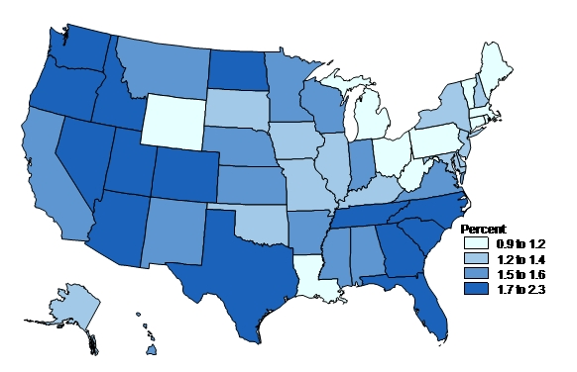
New England Is Ahead of the Curve, but Slow Growth Ahead
Employment Growth 2011-2017 Annual Rate
Source: IHS Global Insight
The unemployment rate for New England currently sits below 8%, an improvement on the national 9.0% rate. However, employment growth going forward will be slow.
RI unemployment stood at 10.6% in August, the lowest it’s been since May 2009.
Employment in Leisure and Hospitality in RI should reach 2007 peak in 2013

Slide 52
Economic Recovery Will Pick Up Steam Going Forward
Annual Economic Growth for NE and RI
Source: IHS Global Insight; based on nominal dollars
The economic recovery has been slow to get started, but should top 4% annually after 2014.
Rhode Island’s L&H industry will surpass the 2007 peak this year, but growth after 2012 will be muted.

Slide 53
Talking Points: What Do Visitors Mean to RI?
  If tourism didn’t exist, each household would pay $1,310 more in taxes to maintain the current level of state and local tax receipts
  Each visitor creates about $119 in tax receipts, $69 of which goes to state & local authorities
  It takes only 198 visitors to pay for one Rhode Island public school student for one year
  Each RI visitor/traveler generates about $444 in expenditures, $88 of which goes to RI businesses that do not directly “touch” that visitor
  Every 187 visitors creates a new RI job
  Each visitor adds about $210 to RI Gross State Product

Slide 54
Thank You!
Shane Norton
Senior Consultant, Travel & Tourism
shane.norton@ihsglobalinsight.com

