Slide 1
Minor League Baseball and Local Economic Development
Victor Matheson, College of the Holy Cross
Blackstone Valley Tourism Council, May 2015

Slide 2
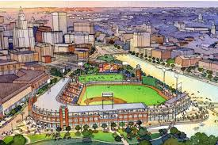
Are sports stadiums and events a wise use of taxpayer money?

Slide 3
Commercial sport is heavily subsidized in the US
“Without professional sports the Twin Cities are just a cold Omaha” – H.H. Humphrey, 1976
“Stadiums should be like libraries. If the taxpayers build it, they should be able to use it for free.” – Jesse Ventura, 1999
“This should be the ‘people’s stadium’.” – Mark Dayton, 2013

Slide 4
The Minor League Stadium boom
Between 1992 and 2006, 100 of 192 minor league teams across the US built new stadiums (including 7 out of 14 teams in International League.)
Stadium boom has continued with at least 8 new stadiums in AAA alone since 2007.
McCoy Stadium is the oldest stadium at AA or AAA in US and one of only 3 opened before 1980.
Only two older stadiums are Fenway and Wrigley.

Slide 5
Taxpayer stadium financing
26 out of 30 stadiums in MLB, $5.5 billion, 60% of costs.
An estimated 85% of construction costs for minor league stadiums covered by taxpayers (through 2004.)
McCoy Stadium, 1942, $1.5 million; 1966, $100,000; 1999, $14.9 million upgrades.
The average new AAA stadium cost $33 million (2006).

Slide 6
Providence stadium finances
$4 million/year for 30 years - $69 million in NPV
Property tax exemption - $4.2 million - $73 million NPV
Land giveaways - ????
Infrastructure - ????
Total - $142 million plus land and infrastructure costs
- 80% of construction costs

Slide 7
“Economic Impact” Studies
Often commissioned by groups with a vested interest in the outcome of the study. Used to justify public subsidies.
Typically measure gross economic impact not net economic impact.
Generally ignore substitution effects, crowding out, and large leakages from sports.
Exaggerate opportunities for outside events.

Slide 8
Independent Economists
Look back after new stadiums, new/relocated franchises, work stoppages, or mega-events.
Measure income, GDP, employment/unemployment, taxable sales, tourist arrivals, or hotel occupancy.
Remarkable agreement among economists, finding that spectator sports result in little or no measurable economic benefits on host cities.
Expensive methods to promote local development.
As a rule of thumb, take whatever the boosters say and move the decimal point one place to the left.

Slide 9
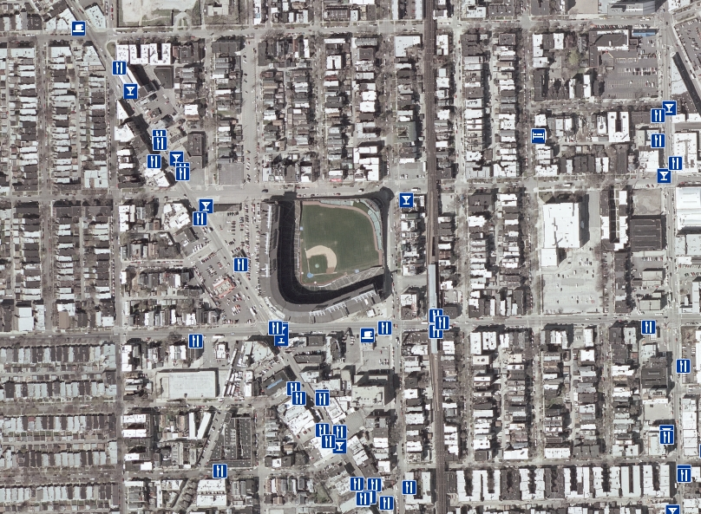
The sales job – Wrigley Field

Slide 10
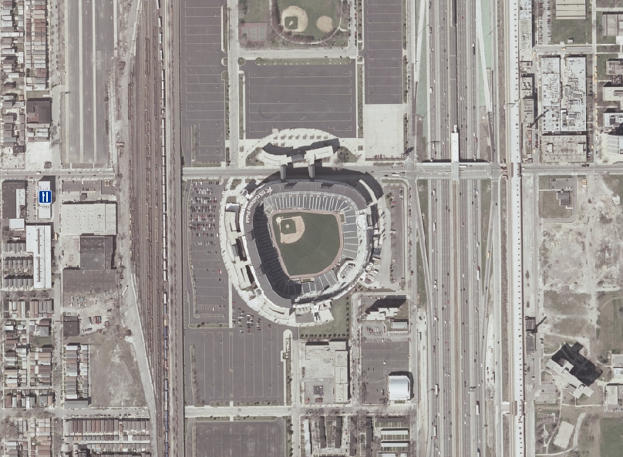
The reality – U.S. Cellular Park

Slide 11
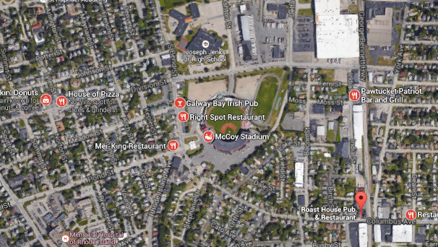
The reality – McCoy Stadium

Slide 12
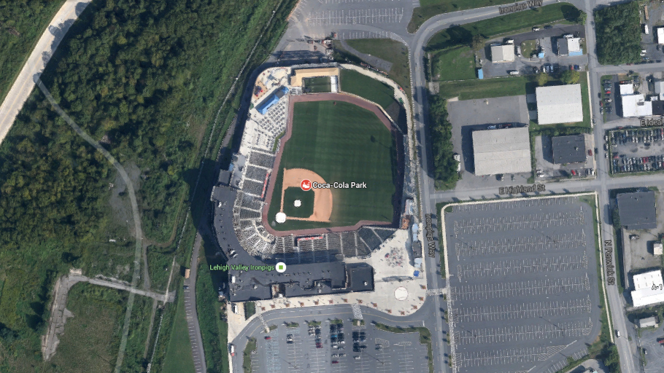
The reality – Lehigh Ironpigs

Slide 13
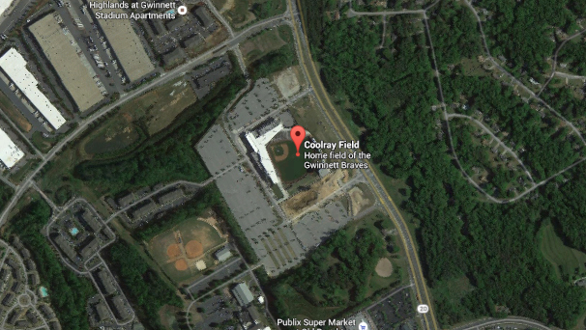
The reality – Gwinnett

Slide 14
What does stadium do for team?
New AAA stadiums raise attendance by 2,200 in 1st year.
By year 10, attendance bump down to 250/game.
880,000 total bump over 10 years.
Ticket prices rise $1.60 in first year (about +20%).
Total revenues increase $2.7 million/year

Slide 15
Stadium comparisons
Andy Zimbalist - "aggressive," but "not outlandish.”
Minor league teams vs. movie theaters
Pawsox, 2014 – attendance 540,000
Average 16-screen Regal mega-plex, 2014 – 478,000
Are movie theaters exempt from sales tax, property tax, market value leases, etc.?

Slide 16
Stadium comparisons
Minor league teams vs. factories
Pawsox, 2015 – 30 full-time employees + 70 FTE game day workers = 100 jobs
$8 million annual subsidy or $80,000/job
South Carolina, 2015 - $500 million Volvo factory – 2,000 full-time employees
$7 million annual subsidy or $3,500/job

Slide 17
Where would PawSox go?
Rank | City | Population | Baseball | Other
28 | Cincinnati, OH | 2,149,449 | MLgB | Y
29 | Kansas City, MO-KS | 2,071,133 | MLB | Y/Y
30 | Las Vegas, NV | 2,069,681 | AAA
31 | Cleveland, OH | 2,063,598 | MLB | Y/Y
32 | Columbus, OH | 1,994,536 | AAA | Y/Y
33 | Indianapolis, IN | 1,971,274 | AAA | Y/Y
34 | San Jose, CA | 1,952,872 | A | Y/Y/Y
35 | Austin, TX | 1,943,299 | AAA
36 | Nashville, TN | 1,792,649 | AAA | Y/Y
37 | Norfolk, VA | 1,716,624 | AAA
38 | Providence, RI | 1,609,367 | ???
39 | Milwaukee, WI | 1,572,245 | MLB | Y

Slide 18
Where would PawSox go?
Rank | City | Population | Baseball | Other
37 | Norfolk, VA | 1,716,624 | AAA
38 | Providence, RI | 1,609,367 | ???
39 | Milwaukee, WI | 1,572,245 | MLB | Y
40 | Jacksonville, FL | 1,419,127 | AA | Y
41 | Memphis, TN | 1,343,230 | AAA | Y
42 | Oklahoma City | 1,336,767 | AAA | Y
43 | Louisville, KY | 1,269,702 | AAA
44 | Richmond, VA | 1,260,029 | AA
45 | New Orleans, LA | 1,251,849 | AAA | Y/Y
46 | Raleigh, NC | 1,242,974 | AAA | Y
47 | Hartford, CT | 1,214,295 | AA
48 | Salt Lake City, UT | 1,153,340 | AAA | Y/Y

Slide 19
Where would PawSox go?
City | Population | MLB | Paw. | Stadium
Pawtucket | 1,609,367 | 46 | 0 | 10,031
Providence | 1,609,367 | 50 | 5 | None
Worcester | 930,473 | 46 | 38 | 3,000
New Bedford | 95,078 | 59 | 33 | None
Springfield | 629,100 | 90 | 84 | None
New Haven | 861,277 | 136 (80) | 107 | 6,200
Pittsfield | 128,715 | 136 | 130 | 4,500
Montreal | 3,824,221 | 308 | 353 | 45,757
Ottawa | 1,236,324 | 280 | 473 | 10,332

Slide 20
Where would PawSox go?
Tim Murray, President and CEO of the Worcester Regional Chamber of Commerce. “If the deal were to fall apart, I think people here would be willing to listen, but everyone recognizes this requires significant municipal assistance. Massachusetts, traditionally, has been reluctant to use tax dollars to those kind of things, and I think in most cases, appropriately so.”

Slide 21
Non-monetary benefits
Name-recognition/advertising
Google news hits for “Pawtucket” – 55,300 hits
Google news hits for “Pawtucket Sox” – 33,600 hits
Civic pride
Public amenity – family entertainment (less accessible in a new stadium)
Alternative uses (limited)

Slide 22
Conclusions and policy implications
Professional leagues are extremely effective at exerting their monopoly power to pit city against city and neighborhood against neighborhood.
Cities can and should take steps to prevent sports from “playing” cities rather than the other way around.

Slide 23
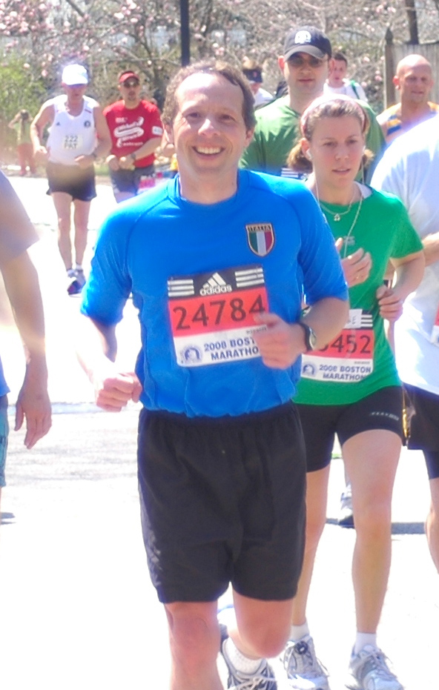
A final comparison
Marathons vs. professional sports
Boston Marathon is worlds oldest, most prestigious (and fastest) marathon in the world.
Attracts roughly as many live spectators each year as the Patriots, the Bruins, or the Celtics.
Among the most “non-local” races in the world.

Slide 24
The Boston Marathon
The Boston Marathon receives no public subsidy.
Honolulu Marathon, which generates as many new net arrivals as the Pro-Bowl, receives no subsidy while the Pro-Bowl receives a direct payment in excess of $5 million from the HTA.
Why?
No one has a monopoly on the distance 26.2 miles.

Slide 25
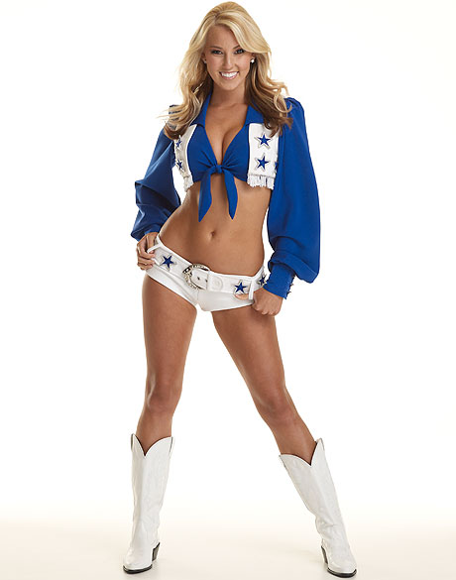
Why do teams get subsidies?
Classic special interest problem in political economy.
A small number of people stand to make huge profits – owners, players, construction
firms, media, etc.
A large number of people stand to
lose a small amount over a long
period of time.
Jerry Jones – spent over $1 million
lobbying for new stadium in Arlington.
Opponents spent $20,000.

Slide 26
Substitution Effects
Most fans at sporting events are local residents. Their spending at sporting events displaces spending elsewhere in the economy.
Typically 80% of fans at sporting events are local residents.
A night at the ballpark is one less night out on Federal Hill.

Slide 27
Crowding out
Crowds and congestion associated with sporting events deter other visitors.
“Nobody goes there anymore. It’s too crowded.” – Yogi Berra
Evidence? NFL Pro-Bowl in Honolulu. Attracts 28,000 out of state attendees. Visitor arrivals in Hawaii are only 6,000 above normal during Pro-Bowl week.
More evidence? Ski resorts in Utah 2002.
More evidence? Broadway and London shows.
More evidence? Great America vs. SF 49ers.

Slide 28
Leakages
Nationwide, roughly 95% of the labor force lives full-time in the metropolitan area in which they work. Most workers are also local hires.
In the NBA, 20% of players live during the offseason in the city for which they play. Almost none live locally prior to hiring.
Mega-events have additional issues. Prices increase but wages don’t. Also, specialized labor may be imported for the event. (Back)

